Slide 1
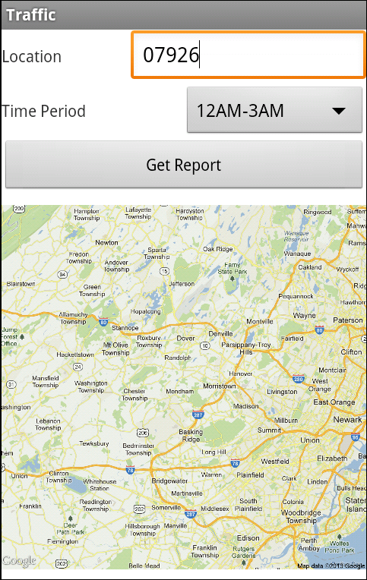
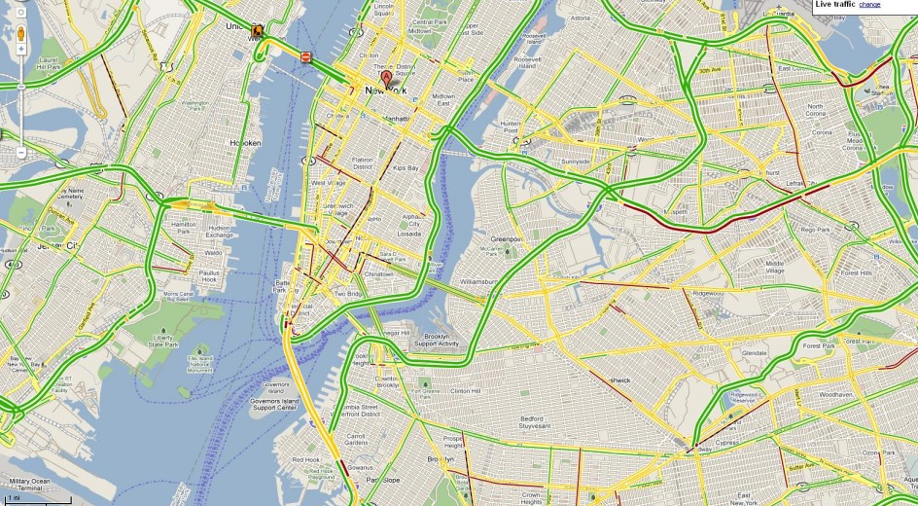



Traffic Monitoring System
Matt Araneta
Kevin Hsieh
Geoffrey Oh
Peter Lin
John Reed
Mike Simio

Slide 2
Features
View Traffic History & Weather Conditions at the Desired Location and Date
View Best Route based on Traffic Algorithm
Obtains Traffic Incident and Weather data at Regular Time Intervals
Stores this Data into a Database
Traffic Report Accessible Through Android App
Users can report Traffic Incidents through App

Slide 3
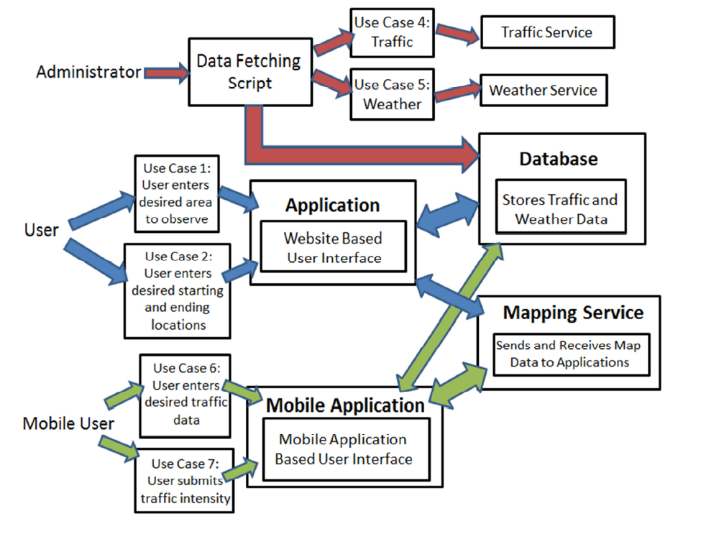

Slide 4
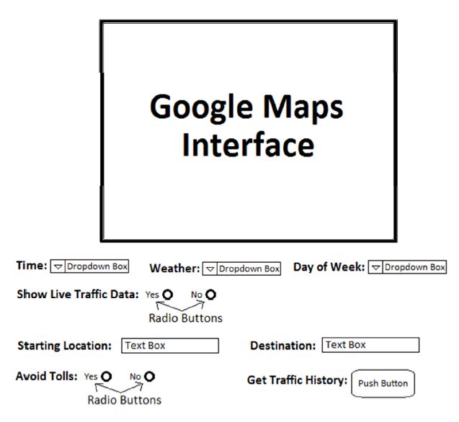
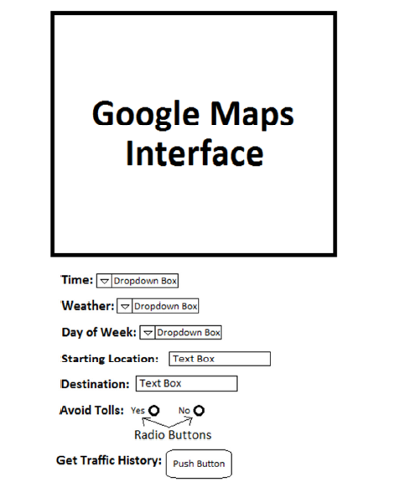

Slide 5
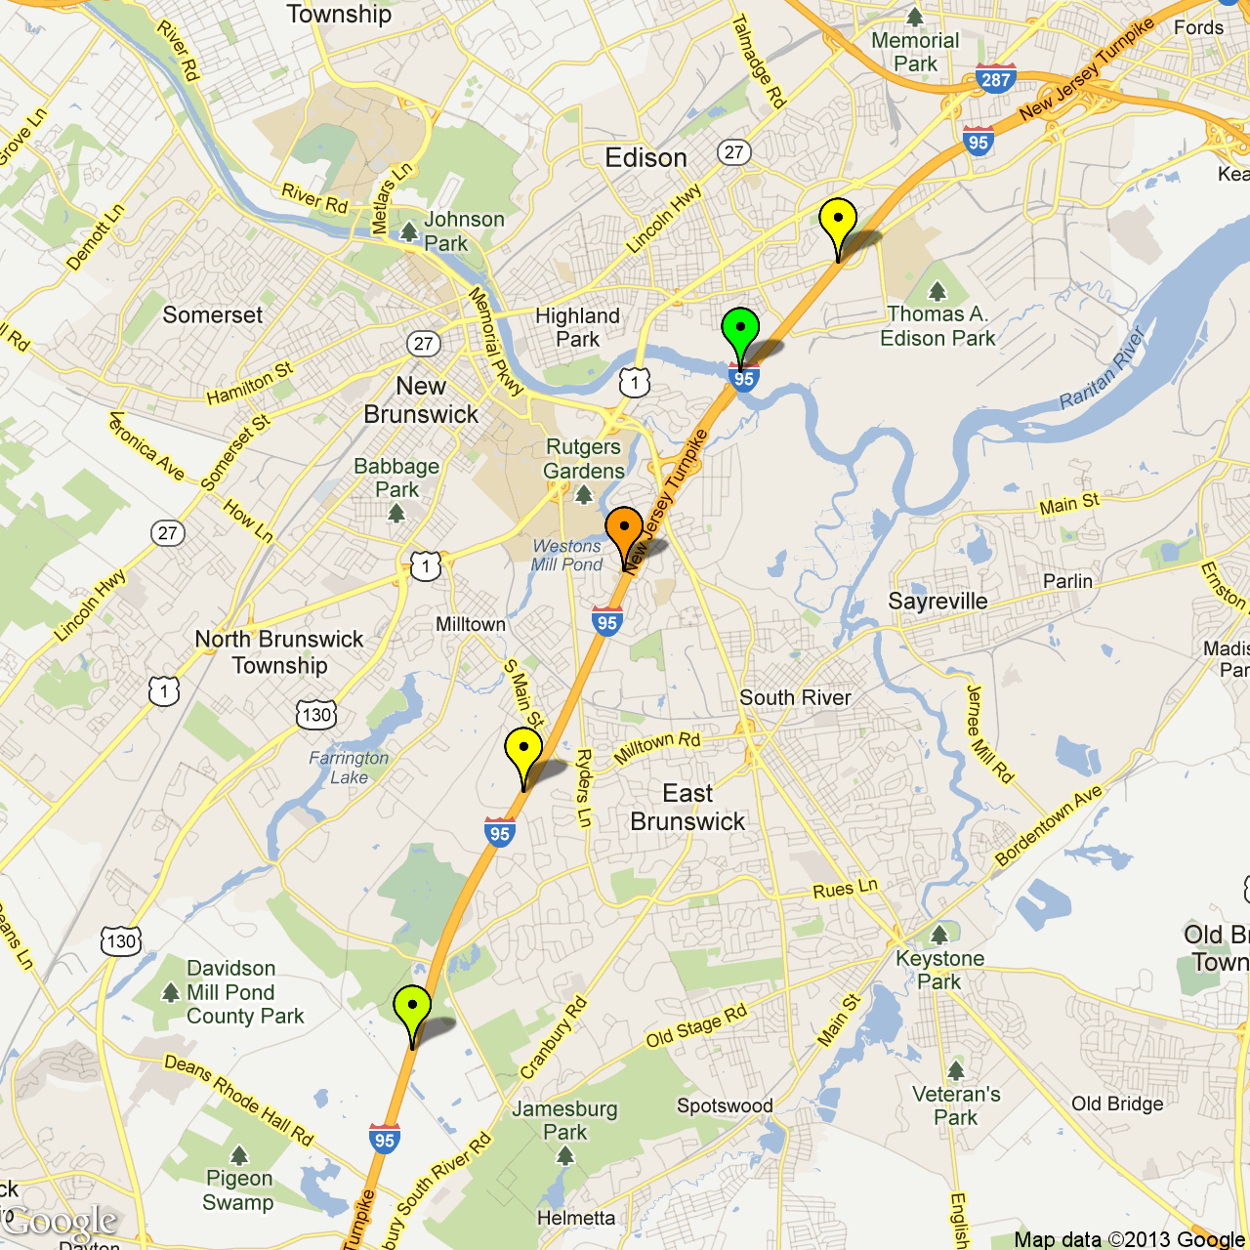
Traffic History Website
http://traffichistory.co.nf/index.php

Slide 6
Description
Provides online view of traffic incident areas
User interface friendly and easy to use

Slide 7
Implementation
Relies heavily on data collected by scripts and large databases
Image and points placed using google maps api
Contains own algorithm to create traffic incidence area and historical traffic severity
Uses perl within scripts to apply our algorithm and before insertion into database

Slide 8
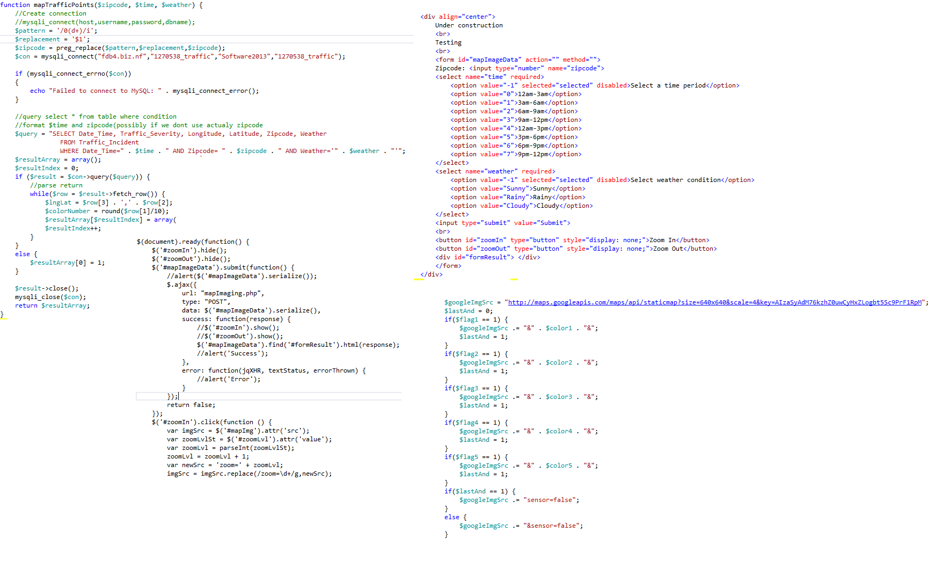
Technical
We used php to do the server-side coding and used jquery for client-side coding.

Slide 9


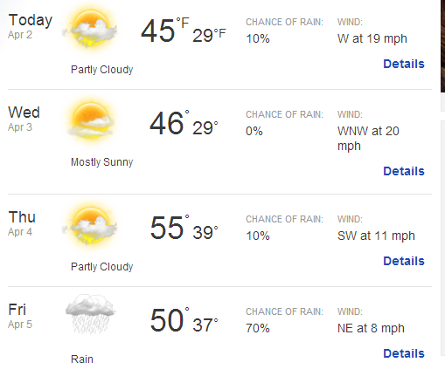


Data Collection

Slide 10
Data Collection
Used Perl Scripts to Access Websites
Converted XML Files and JSON Objects
Weather API
MapQuest API
511NJ
List of Zip Codes for Locations
Saved to Output File & Stored in a Database

Slide 11
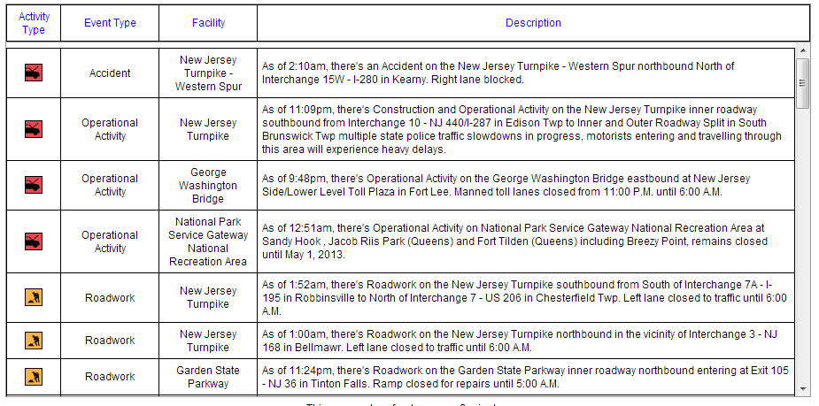
Data Collection

Slide 12
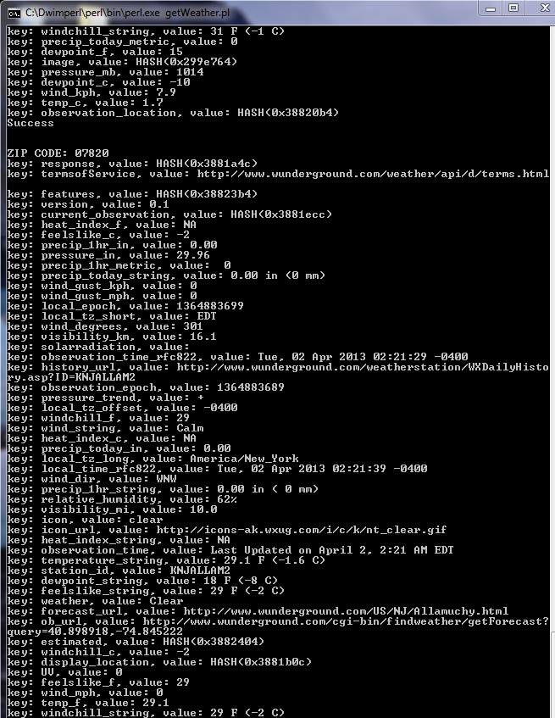
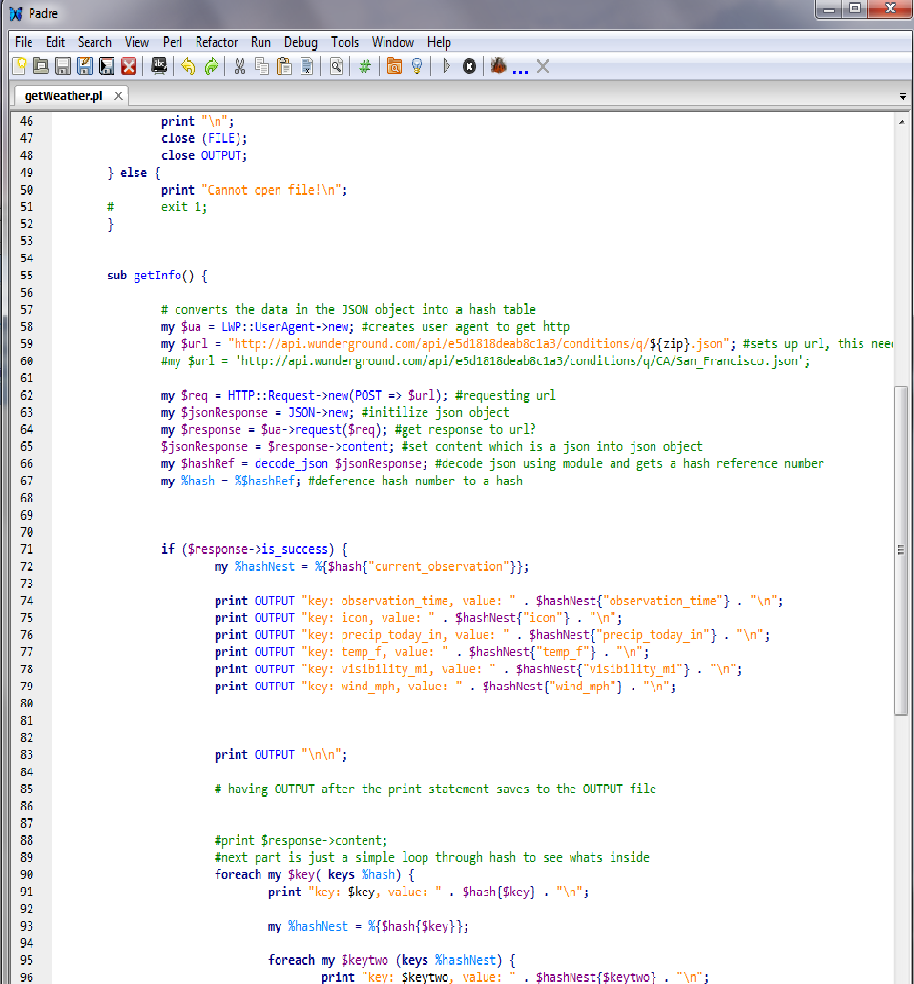

Slide 13
Data Storage
Matt’s Slide

Slide 14

Mobile System
Android Application for mobile use of the traffic system

Slide 15
Description
Provides the user with remote access to the traffic system.
The user can either request a traffic report or send an update to the database via the mobile application.

Slide 16
User Experience
At the main menu, the user selects to get a traffic report or send a traffic report.
To get a traffic report, the user enters his or her location and the current time and gets a picture of their current location.
To send a traffic report, the user selects the traffic intensity of their current location and updates the database with new values.

Slide 17
Implementation
The application communicates with the web system via an http request.
The http request is parsed to receive the map image.

Slide 18
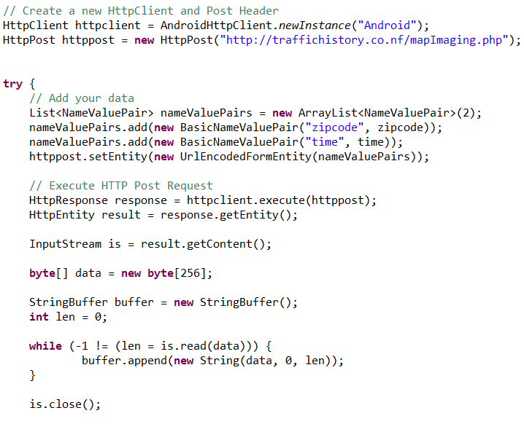
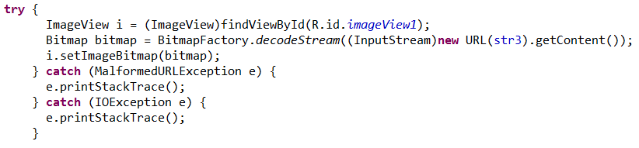

Slide 20
Future features
Add users (log-in, preference)
Dynamic map to select points to view
Directions service with route planning altered with out road data
More user friendly features (auto complete zipcode, township to zipcode, more options to view history maps sizing)
Replace points with overlay of area affected
Upgrade Website for more storage in the Database
Continue adding more sources of Traffic Info from APIs (Bing Maps API, Nokia Maps API)

